Slide 1
Life Insurance
Jeevan Kulkarni

Slide 2
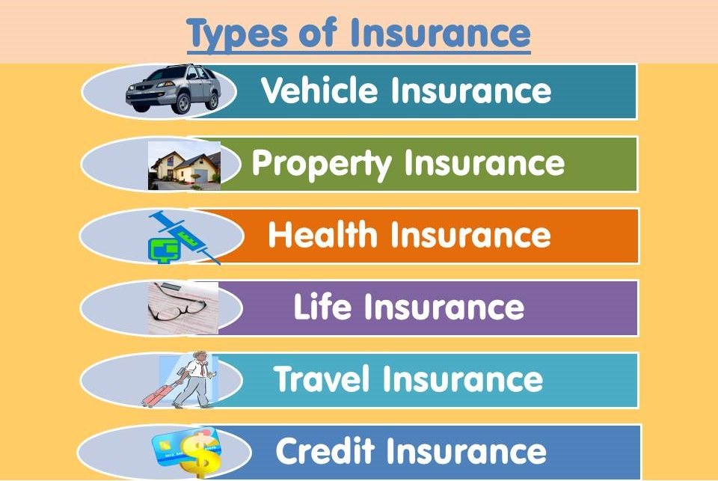

Slide 3
Agenda
Requirement
User stories
Agile Process-Meeting
Project architecture basics
Project architecture in details
Java package structure
Domain and functional knowledge of project
Spring Boot Configuration
How to build the Restful Web services as per business requirements.
Angular Package structure and services **
How to consume Restful API in angular **
How to starts writing REST API into Industry

Slide 4
Agenda
Postman
Coding standards
Debugging the code
Factory Design Pattern Project Live example
Bit Bucket- Push and Pull code
Different Server in company
How to handle transection management
How to configure the logger into Project
How to design custom exception in java
Hibernate Mapping with live example*
Junit
Swagger

Slide 5
Agenda
How to write the Custom Query in live project
How to perform manual testing in project
Technologies
JIRA
Life Insurance Release Notes
Life Insurance version Known issue list.
Deployment (Angular + Rest API)
Roles and Responsibilities
Life Insurance Manual
Life Insurance Restful Service- Dev Guide
Daily status
Insurance application flow

Slide 6
Domain Knowledge
Insurance
Insurer
insured person
Policy
Premium
Claim
Intermediaries
Commission
Beneficiary
Rider
Grace Period
Maturity
Sum assured
Settlements
Transfer
Clearance
Rate
Buyer

Slide 7
Functional Knowledge
Claim
Quotation
Documentation
Bank details
Transfer
Agent details
Receipt processing
Refund premium
Post dated cheques
Clearance
Rate
Buyer
Payment
Tax
Company
Agent
Branch
Feedback
Comparison
Property
Policy Master
Insurer
Nominee
Premium details
Account
Transection
Settlement
Reports
Login
Authority User
Exchange rate, currency

Slide 8
Technologies
Programming language - Core Java
Front End - Angular
Web service - Restful
Frameworks-Spring Boot, Hibernate
Database-MYSQL
Server - Apache tomcat
Version control- GIT/BitBucket
Building tool- Maven
SDLC - Agile
Testing- Manual testing
Log management tool- Logger
API testing tool- Postman
Project management tool- JIRA
IDE- Spring Tool Suite(STS)
Editor- visual studio code
Design pattern

Slide 9
Roles and Responsibilities
Working as team member
Producing the restful web service
Analysis the requirement, coding, testing, etc.
Prepare the test plan
Perform the manual testing
Bug fixing
Analyze the program to identify the code changes as per business requirement.
Involved in knowledge sharing activities in the team.
Prepared the technical specification document based on existing system

Slide 10
Insurance flow system-I
Flow- 1
Registration-> Login->User->View Account->Transection-> Premium history-> Notification for premium->View Profile->Edit Profile->Change Password
Flow- 2
Login->User->View Policy->Check Premium> Ask for Quotation->Book Policy-> Nominee details-> Payment->Invoice Generate
Flow- 3
Login->User->View Policy-> Mature Policy->Claim request->upload bank details>Receive claim request-> Record->Validate claim document->Analyze claim->Yes->Claim settlement->Record settlement->Close claim->No->Request for data

Slide 11
Insurance flow system-II
Flow- 4
Login->User->View hospitalization->Get Admitted->Pre authorization by hospital->Treatments->Discharge
Flow- 5
Login->User->Death claim->Documents need to upload on portal->verify from system->online or cheque will be sent to nominee.
Flow- 6
Login->Admin->Add Plan->Approved request->Claim Process->Settlement

Slide 12
Insurance flow system-III
Flow- 7
Login->Admin->Customer, Agent->Policy Payment->Withdraw Payment->Commission->Transection
Flow- 8
Login->Agent->Policy Registration->Agent commission->commission report-> Earning report-> Withdraw commission report

Slide 13
Thank you.

